Slide 1

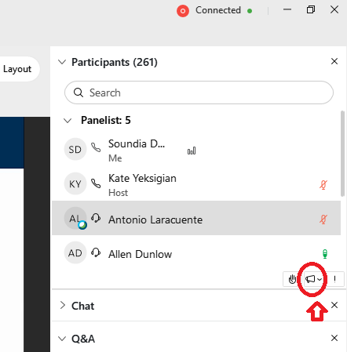
Webinar
Housekeeping
Dial in: 1 – 404 – 397 – 1596
Access Code: 2760 - 552 -9675
Slides in SharePoint Link “Q&A” Tab
We would be ever so grateful if you would complete the post-webinar evaluation survey that pops up once you exit the webinar.
Experiencing sound issues – you can call in using the number included on the handouts and on your registration confirmation email that you received.
Handouts were sent out in advance to those that registered for the webinar…by the time we sent the handouts out.
  Check the Q&A box for the link to the SharePoint site where you will be able to download the handouts.
Please use the Q&A feature to submit questions.
  Please do not use Chat to send in questions.
  Be sure to send questions to “All panelists”.
Be heard! Use the gramophone found at the bottom of the participant list to give us feedback during the webinar

Slide 2
Electronic Documentation of Written Informed Consent
Dial in: 1 – 404 – 397 – 1596
Access Code: 2760 - 552 -9675
Slides in SharePoint Link “Q&A” Tab
Erica Aulik, Nigel Clarke, Janet Fawcett,
Paska Permana, April Primous
Office of Research Protections, Policy, and Education
October 14, 2021

Slide 3
Objectives
  Provide a general overview of research informed consent and documentation for IRB-approved informed consent documents and written HIPAA authorizations for research
  Describe different types of electronic documentation of written informed consent
  Describe the consenting process using iMedConsent
  Describe the consenting process using DocuSign

Slide 4
Types of Actions Regarding Consent
Documentation of Informed Consent approved by the IRB
  Required for all greater than minimal risk studies in VA
Waiver of Documentation of Informed Consent
  Regulatory criteria must be met according to the Common Rule or FDA requirements (if FDA regulated) as determined by the IRB
  The information must still be provided to subjects (or subject’s legally authorized representative [LAR]) in the informed consent process, but the IRB does not require subject or subject’s LAR to sign the form
Alteration of Informed Consent
  Minimal risk studies only
  Where one or more of the basic elements of consent are not required by the IRB
  A signed document is required unless documentation is also waived.

Slide 5
Who can sign the written IRB-approved informed consent document?
Research subject, or
Research subject’s Legally Authorized Representative
  A legally authorized representative (LAR) is an individual or judicial or other body authorized under applicable law to consent on behalf of a prospective subject to the subject's participation in the procedure(s) involved in the research. If there is no applicable law addressing this issue, LAR means an individual recognized by institutional policy as acceptable for providing consent in the non-research context on behalf of the prospective subject to the subject’s participation in the procedure(s) involved in the research.
(VHA Directive 1200.05)

Slide 6
Who can sign the written HIPAA Authorization for research?
  Research subject, or
  Research subject’s Personal Representative
  A personal representative is a person who, under applicable law, has authority to act on behalf of the individual to include privacy-related matters. The authority may include a power of attorney, legal guardianship of the individual, appointment as executor of the estate of a deceased individual, or a Federal, State, local or tribal law that establishes such authority (e.g., parent of a minor).
  (VHA Directive 1605.01)

Slide 7
Documentation of Informed Consent
Informed consent shall be documented, unless documentation is waived by the IRB, through the use of a written consent form approved by the IRB and signed and dated by the subject or the subject’s Legally Authorized Representative.
A physical or electronic copy must be given or made available to the person signing the form.
Documentation of consent may be obtained electronically so long as the informed consent process meets all requirements in section 18 of VHA Directive 1200.05 (Requirements for the Protection of Human Subjects in Research) and VA requirements for use of electronic signatures.

Slide 8
Documentation of Informed Consent cont’d
The informed consent form may be combined with the HIPAA Authorization form if (a) the study does not involve optional banking of identifiable private information or identifiable biospecimens or (b) the study does not involve consent by subjects’ legally authorized representatives.
Documentation of informed consent that is permitted under clinical procedures as described in VHA Directive 1004.01: “Informed Consent for Clinical Treatments and Procedures” does not apply for research.
Researchers cannot sign on behalf of a VA subject or as a VA subject’s legally authorized representative (LAR) on a written informed consent document approved by the IRB.
ORD is in alignment with FDA for obtaining informed consent in clinical trials as published in FDA Guidance on Conduct of Clinical Trials of Medical Products during COVID-19 Public Health Emergency: Guidance for Industry, Investigators, and Institutional Review Boards (https://www.fda.gov/media/136238/download)

Slide 9
Waiver of Documentation of Consent
38 CFR 16.117(c)(1): An IRB may waive the requirement for the investigator to obtain a signed informed consent form for some or all subjects if it finds any of the following:
That the only record linking the subject and the research would be the informed consent form and the principal risk would be potential harm resulting from a breach of confidentiality. Each subject (or legally authorized representative) will be asked whether the subject wants documentation linking the subject with the research, and the subject’s wishes will govern;
That the research presents no more than minimal risk of harm to subjects and involves no procedures for which written consent is normally required outside of the research context; or
If the subjects or legally authorized representatives are members of a distinct cultural group or community in which signing forms is not the norm, that the research presents no more than minimal risk of harm to subjects and provided there is an appropriate alternative mechanism for documenting that informed consent was obtained.

Slide 10
Wet vs. Electronic/Digital Signatures
Signatures can be obtained when a person physically marks a document, referred to as a “wet signature,” or through electronic/digital signatures, such as an electronically-captured signature made on a touch device or checking a box using a Personal Identity Verification (PIV) card to generate a digital signature.
  research guidance_use of electr methods_obtain informed consent_101520.pdf (sharepoint.com)

Slide 11
Electronic Documentation of Informed Consent in VA Research
iMedConsent Web
DocuSign
Other electronic consenting methods approved by the ISSO for the study, e.g.:
  Million Veteran Program
  All of Us Research Program

Slide 12
Primary Factors to Consider
1. Subject population:
  In-hospital:
    Inpatient
    Outpatient
  Remote
2. Study design:
  Optimal for the subject
  Recruitment at Point of Care?
  Consenting followed with initial research procedure?
  Certificate of Confidentiality?

Slide 13
Platform Characteristics
iMedConsent
Integrated in VistA/CPRS (and CERNER); pull in subject’s name etc. from medical record.
21 CFR 11 compliant
“Report Viewer” option
Needs access to VA network
Local iMedConsent Administrator
Request locally
Needs Word documents as input
No cost to study team
DocuSign
Utilizes DocuSign server
Requires a waiver of HIPAA Authorization to disclose name and email address of prospective subjects to DocuSign
Two types of envelopes (21 CFR 11 compliant or not)
Study team, but not subject, needs access to VA network
Administered by the Identity & Access Management (IAM) Team
Request ORD to use
Currently no cost to study team

Slide 14
iMedConsent Web for VA Research
iMedConsent Legacy → Web
  iMedConsent Web Home (va.gov)
  Online Training - iMedConsent Web (va.gov):
    iMedConsent Web User Guide
    Video demonstration of iMedConsent Web
    iMedConsent Web Tri-Fold
How to start using iMedConsent for VA Research?
  Identify the iMedConsent Administrator (e.g. Clinical Application Coordinator): local iMedConsent Web Facility Administrators
  Develop a local administrative process connecting study team, IRB Administrator, and iMedConsent Administrator (upon study initiation and for amendments)

Slide 15

Demo: Using iMedConsent
    By Janet Fawcett, PhD, Research Methodologist, Phoenix VAHCS

Slide 16
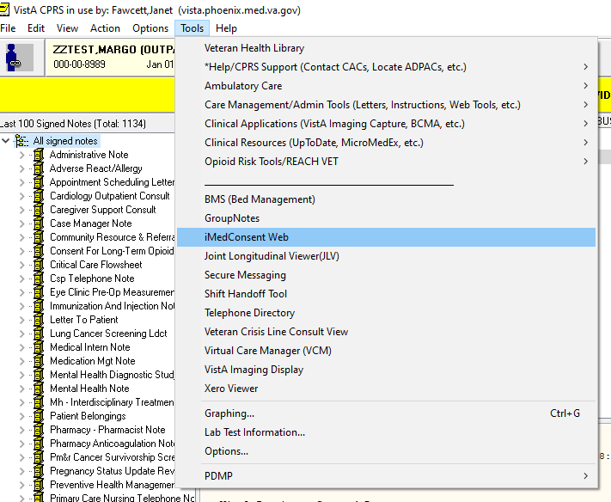
iMedConsent Web - CPRS

Slide 17

iMedConsent Demo

Slide 18
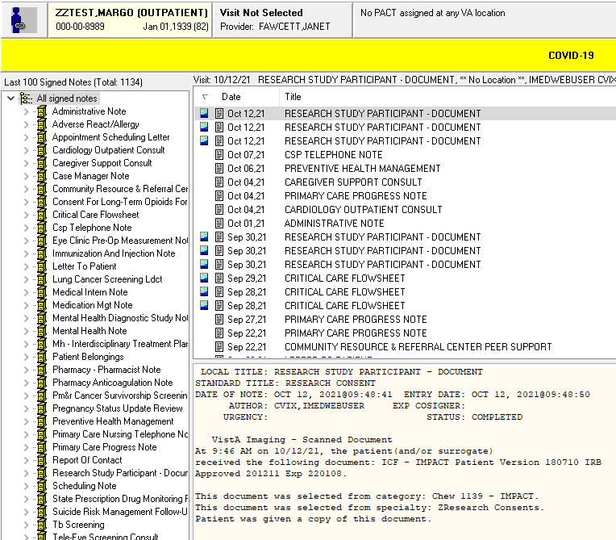
iMedConsent Web - CPRS

Slide 19
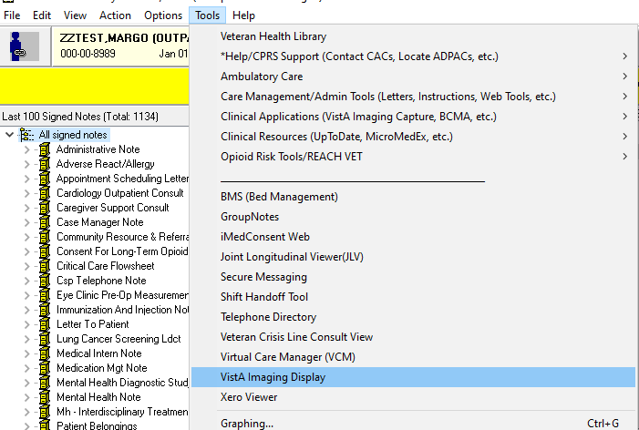
iMedConsent Web – VistA Imaging

Slide 20
DocuSign for VA Research
How to start using DocuSign for VA Research?
  By Erica Aulik, Instructional Designer, ORPP&E
  Requesting use of DocuSign IC (website)
  DocuSign Requests - Home (sharepoint.com)
Demo on using DocuSign
  By April Primous, IT Specialist, Project Manager, DocuSign and Nigel Clarke, Functional Analyst, Identity and Access Management (IAM)

Slide 21

Demo: Requesting DocuSign

Slide 22
DocuSign for VA Research - Process
  Submit Service Request (SR) on IAM DocuSign eSig Playbook page link.
  IAM DocuSign eSig team sets initial meeting with study team POCs to review process and verify use case.
  Study teams send IRB approved forms to DocuSign team email: DocuSign SaaS service IAMDocuSignPOCs@va.gov
  IAM DocuSign eSig team creates templates using the forms. DocuSign technical analyst will work with the team POCs to determine workflows.
  Demo/Sandbox: IAM DocuSign eSig team will set up a training meeting with the study team, then the study team is set up to test their forms, verify workflows and practice sending documents.
  Production: Study team POCs will let the IAM DocuSign team know they are finished testing and would like to move to production.

Slide 23
Case Study
  Your study will randomize patients hospitalized with severe COVID-19 symptoms (who may be intubated) to receive an investigational product or a placebo. What consenting method could be applicable for this study? (check all that apply)
  Paper
  iMedConsent
  DocuSign
  Request Waiver of Documentation of Informed Consent
  (Please select your answer on the right hand-side of the screen. Then hit the submit button)

Slide 24
Case Study - Answer
  Your study will randomize patients hospitalized with severe COVID-19 symptoms (who may be intubated) to receive an investigational product or a placebo. What consenting method could be applicable for this study? (check all that apply)
  Answer: (a) and (b) and maybe (c)
  Paper
  iMedConsent
  DocuSign – e.g. obtain consent from subject’s LAR
  Request Waiver of Documentation of Informed Consent

Slide 25
Availability of Recording
A recording of this session and the associated handouts will be available on ORPP&E’s Education and Training website approximately one-week post-webinar
An archive of this and other webinars can be found here: https://www.research.va.gov/programs/orppe/education/webinars/archives.cfm

Slide 26
References
VHA Directive 1200.05: Requirements for the Protection of Human Subjects in Research (January 7, 2019; second amendment January 8, 2021)
VHA Directive 1605.01: Privacy and Release of Information (August 31, 2016)
ORPPE Workshop: Informed Consent Tools (January 11, 2019)
Spring Research Town Hall (May 4, 2020)
research guidance_use of electr methods_obtain informed consent_101520.pdf (sharepoint.com) (October 15, 2020)

Slide 27
Contacts
Regulatory: VHACOORDRegulatory@va.gov
iMedConsent general:
    Paul.Tompkins@va.gov (National Center for Ethics in Health Care)
    VHAiMedConsentWeb-FacilityPOCs@va.gov
iMedConsent specific: local administrators
DocuSign request to ORD:
    Erica.Aulik@va.gov (ORPP&E)
Questions on DocuSign request, process, and updates:
    IAMDocuSignPOCs@va.gov, referencing the Service request number, the study project name and, if applicable, which part of the forms have been updated.

Slide 28

Q&A
Please type any questions you may have in the Q&A box.
We will try to answer everyone’s questions before the close of the hour.

Slide 29
Thank You!!!

